Slide 1

Security using Facial Recognition
Under the Guidance of
Dr.Amjan Shaik, Professor & Associate HOD
Department of Computer Science & Engineering
B V Raju Institute of Technology, Narsapur
Presented by
B.Anirudh, 17211A0529
A.Vinod, 17211A0506
B.Rohith, 17211A0530
K.Venu, 18215A0503

Slide 2
Abstract
Abstract
Introduction
Modules
Architecture Model
Software/Hardware Requirements
Screenshots
Conclusion
Future Enhancement
References
● Through this project we are going to create a facial recognition system which can detect faces of the intruders.
● Whenever a person shows up, the snapshots of his face is given as input to our application.

Slide 3
Abstract
Abstract
Introduction
Modules
Architecture Model
Software/Hardware Requirements
Screenshots
Conclusion
Future Enhancement
References
If the user is a trusted person then our application will notify that person is a trusted one or else it says that he/she is not a trusted one.

Slide 4
Abstract
Introduction
Modules
Architecture Model
Software/Hardware Requirements
Screenshots
Conclusion
Future Enhancement
References
Abstract
Introduction
Existing System
Proposed System
Software requirements
Architecture Model
Modules
UML Diagrams/ER Diagrams/Flow Charts
References
Introduction
•Security now a days has become a major concern in many areas.
•This project can enhance the security in a system by using facial recognition as a means of verifying the person.
•Here we’ll be using a convolutional neural network to recognize a person’s face.

Slide 5
Modules
Abstract
Introduction
Modules
Architecture Model
Software/Hardware Requirements
Screenshots
Conclusion
Future Enhancement
References
1.Creating a dataset file.
2.Uploading trusted faces embeddings into the dataset file.
3.Capture image
4.Preprocessing
5.Compute embeddings
6.Compare
7.Recognise

Slide 6
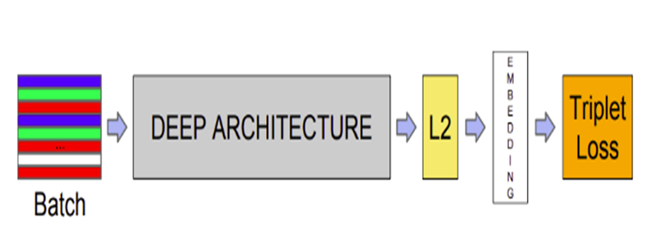
Architectural Model
Abstract
Introduction
Modules
Architecture Model
Software/Hardware Requirements
Screenshots
Conclusion
Future Enhancement
References

Slide 7
Architectural Model
Abstract
Introduction
Modules
Architecture Model
Software/Hardware Requirements
Screenshots
Conclusion
Future Enhancement
References
1)Batch: It is a set of input images for training.
2)Deep Architecture:
It is a FaceNet model. It is a 22 layers deep neural network that directly trains its output to be a 128 dimensional embedding. It uses lot many convolutional layers and pooling layers.
3)L2 normalisation:
It reduces the values of a vector to less than 1,so that the values are in restricted range.

Slide 8

Architectural Model
Abstract
Introduction
Modules
Architecture Model
Software/Hardware Requirements
Screenshots
Conclusion
Future Enhancement
References
4)Triplet Loss:
where A=anchor image
P=positive image
N=negative image
𝝰=margin

Slide 9
Introduction
Existing System
Proposed System
Software Requirements
References
Abstract
Introduction
Modules
Architecture Model
Software/Hardware Requirements
Screenshots
Conclusion
Future Enhancement
References
Software/Hardware Requirements
Software requirements:
•Python environment
•Tensorflow framework(keras)
•Linux OS (preferable)
Hardware requirements:
•8 GB RAM
•1 GHZ processor
•Camera

Slide 10
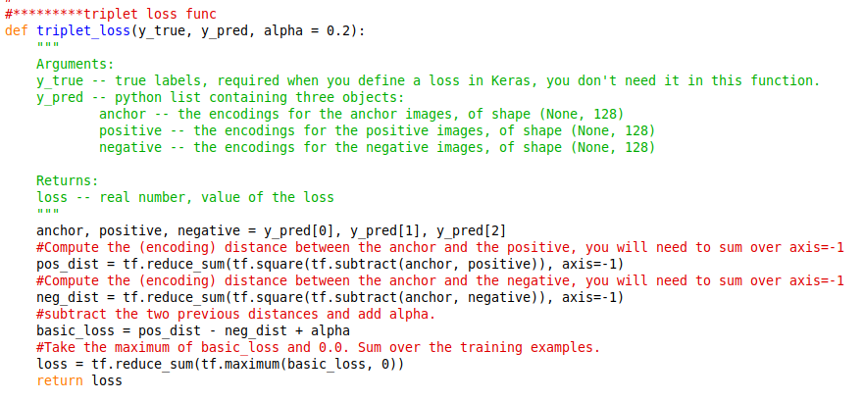
Screenshots
Abstract
Introduction
Modules
Architecture Model
Software/Hardware Requirements
Screenshots
Conclusion
Future Enhancement
References
Triplet loss function:

Slide 11
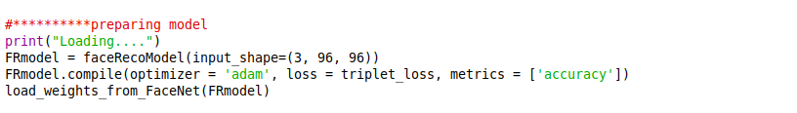
Screenshots
Abstract
Introduction
Modules
Architecture Model
Software/Hardware Requirements
Screenshots
Conclusion
Future Enhancement
References
Making a model:
Our model takes images of dimensions 96 x 96
It uses triplet loss function shown earlier to optimise itself.

Slide 12
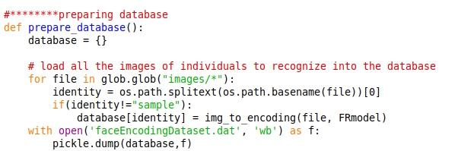
Screenshots
Abstract
Introduction
Modules
Architecture Model
Software/Hardware Requirements
Screenshots
Conclusion
Future Enhancement
References
Preparing Database:
We’ve stored encodings in a dictionary which has person’s name as key and his face encodings as value.

Slide 13
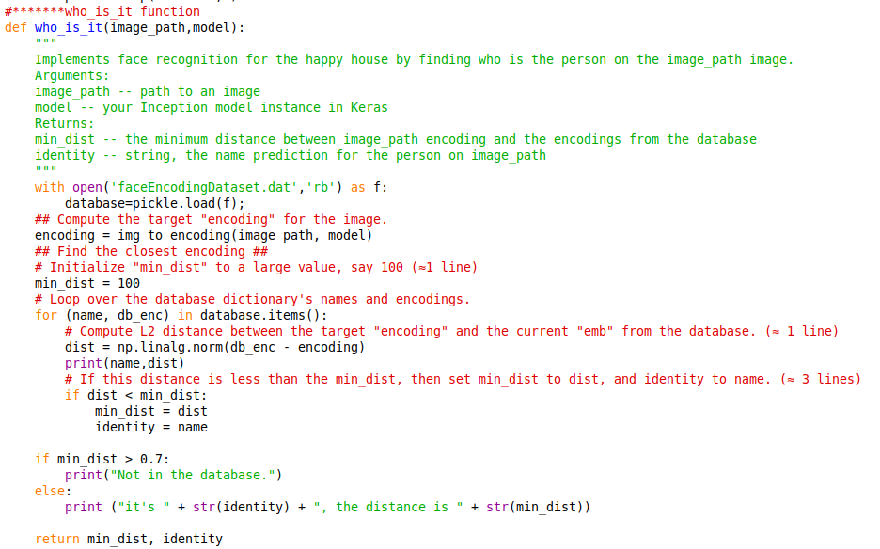
Screenshots
Abstract
Introduction
Modules
Architecture Model
Software/Hardware Requirements
Screenshots
Conclusion
Future Enhancement
References

Slide 14
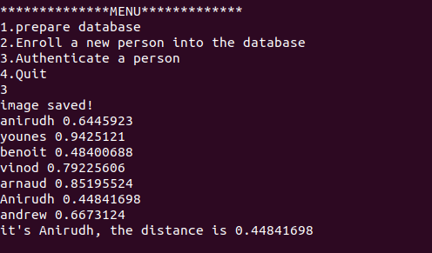
Screenshots
Abstract
Introduction
Modules
Architecture Model
Software/Hardware Requirements
Screenshots
Conclusion
Future Enhancement
References
Interface:

Slide 15
Conclusion
Abstract
Introduction
Modules
Architecture Model
Software/Hardware Requirements
Screenshots
Conclusion
Future Enhancement
References
In a word,with the help of this FaceNet we can recognise a person’s face and decide whether he/she is a trusted one or not.
It can be very useful in various applications where security is of major concern.

Slide 16
Future Enhancement
Abstract
Introduction
Modules
Architecture Model
Software/Hardware Requirements
Screenshots
Conclusion
Future Enhancement
References
We can incorporate this application into an arduino chip with a camera attached to it, so that it can placed at various locations.
We can use a real database so that this can scalable for very large number of people.
We can add a face detection mechanism to make this more accurate.
We can enhance this project with an interface which could be used with locking systems for various applications with facial recognition.

Slide 17
Introduction
Existing System
Proposed System
Software requirements
References
Abstract
Introduction
Modules
Architecture Model
Software/Hardware Requirements
Screenshots
Conclusion
Future Enhancement
References
References
For Journal Papers:
•Florian schroff, Dmitry kalenichenko, James Philbin (2015). FaceNet: A unified embedding for face recognition and clustering
•https://arxiv.org/pdf/1503.03832.pdf
For Books:
[1]. Aurelien Geron: “Hands on machine learning using scikit-learn and tensorflow ”, pp. Total page number-568, Shroff publishers and distributors pvt. ltd., year of publication - 2017.
2/1

Slide 18
Q and A?
?

